Slide 1

MANGALORE INSTITUTE OF TECHNOLOGY & ENGINEERING
(A Unit of Rajalaxmi Education TrustO, Mangalore)
Autonomous Institute affiEated to V.T.U., Belagavi, Approved by AICTE, New Delhi. Accredited by NAAC with A+ Grade, An ISO 9001: 2015 Certified Institution
DEPARTMENT OF ARTIFICIAL INTELLIGENCE AND MACHINE LEARNING
Project Phase
(Subject Code:23AISE309)
" Edge-Optimized ML Framework for Realtime Camouflaged Target Detection in Tactical Military Surveillance Systems "
Project Associates:
Chaithanya R Rao (4MT23AI014)
Gourav (4MT23AI024)
Vinush Kumar (4MT23AI061)
Yakshith K D (4MT23AI062)
Under the Guidance of:
Dr. Maryjo M George
Associate Professor
Dept of AIML

Slide 2
CONTENTS
Abstract
Introduction
Literature Survey
Problem Statement and Objectives
Research Gap
Proposed System
Requirements (Functional, Non-Functional, Software, Hardware)
System Architecture, Execution Flow & Use Case Diagram
Constraints, Testing & Evaluation, Conclusion

Slide 3
ABSTRACT
Modern military surveillance systems struggle to detect camouflaged personnel and vehicles due to high visual similarity between targets and natural backgrounds, leading to missed or delayed threat identification.
Existing camouflaged object detection (COD) models achieve strong accuracy but are computationally intensive, GPU-dependent, and lack real-time validation on resource-constrained edge devices used in drones and battlefield systems.
This research proposes a lightweight, hardware-aware camouflage detection framework optimized for real-time inference on embedded military platforms, incorporating model compression, quantization, and efficient feature modeling.
The system enables live drone video processing with autonomous trigger-based response mechanisms, ensuring secure, low-latency, cloud-independent battlefield surveillance under realistic operational conditions.

Slide 4
INTRODUCTION
Modern military surveillance increasingly relies on UAVs and autonomous reconnaissance systems for real-time intelligence gathering; however, detecting camouflaged personnel and vehicles in complex natural environments remains a major computer vision challenge.
Camouflaged Object Detection (COD) is difficult due to high structural similarity between foreground and background, boundary ambiguity, saliency noise, and limited global–local contextual understanding in existing deep learning models.
Although recent CNN-, transformer-, and attention-based frameworks improve detection accuracy, most models are computationally heavy, GPU-dependent, and not optimized for real-time edge deployment in battlefield conditions.
Therefore, there is a critical need for a lightweight, hardware-aware, real-time camouflage detection framework that can operate autonomously on resource-constrained Combat equipment without cloud dependency.

Slide 5
LITERATURE SURVEY
S.No | Paper Title | Methodology | Limitations | Research Gaps Identified | Year
1 | Deep Gradient Learning for Efficient Camouflaged Object Detection (DGNet) | Dual-branch (context + texture) architecture with gradient-induced transition and an efficient variant (DGNet-S) running at 80 fps | Gradient supervision unreliable in highly textured/low-contrast backgrounds; struggles with small/multi-scale objects; only tested on static images | Adaptive gradient supervision, video COD extension, and better handling of small/occluded objects | 2023
03-03-2025 Dept of AIML 5

Slide 6
LITERATURE SURVEY CONT....
S.No | Paper Title | Methodology | Limitations | Research Gaps Identified | Year
2 | Hybrid- Recursive- Refinement Network for Camouflage d Object Detection | HRRNet combines CNN– Transformer hybrid encoding with recursive decoder refinement and foreground background selection to progressively enhance camouflage segmentation. | High architectural complexity; increased inference cost due to recursive refinement; evaluated mainly on static images; robustness under extreme conditions unclear; real-time capability not demonstrated. | Future work should focus on efficient real- time COD models, stronger robustness testing, and extension to video and edge- device deployment scenarios. | 2025

Slide 7
LITERATURE SURVEY CONT....
S.No | Paper Title | Methodology | Limitations | Research Gaps Identified | Year
3 | Camouflage d Military Personnel Detection Using SSIM- Based Faster R- CNN Model | Two-stage Faster R- CNN detector enhanced with SSIM-based loss component to improve structural differentiation between camouflaged objects and background. Uses perceptual similarity constraints during training. Evaluated using mAP and IoU. | Still based on generic detector; SSIM is low- level perceptual metric (not semantic); limited modality scope (RGB only); computationally heavier; potential overfitting to training textures; no multimodal integration. Slow inference (two-stage detector), not suitable for real time, limited small object handling | Need for multimodal integration; need for transformer- based context modeling; insufficient robustness testing in extreme camouflage; lack of adaptive feature amplification; absence of scene-level reasoning modules. | 2025

Slide 8
LITERATURE SURVEY CONT....
S.No | Paper Title | Methodology | Limitations | Research Gaps Identified | Year
4 | Camouflage d Object Detection Using Hybrid- Deep Learning Model | The model combines a Swin Transformer backbone with Enhanced Receptive Field (ERF) modules and CrossScale Feature Fusion (CSFF) to capture multi-scale contextual features for accurate camouflaged object segmentation. | Complex multi- module pipeline; higher computational overhead; still RGB- dependent; slower inference in some cases; limited real- time and video validation. | Future work should focus on lightweight real- time COD systems, multimodal fusion (e.g., RGB-thermal), and stronger evaluation on dynamic video camouflage scenarios. | 2024
03-03-2025 Dept of AIML 8

Slide 9
LITERATURE SURVEY CONT....
S.No | Paper Title | Methodology | Limitations | Research Gaps Identified | Year
5 | Camouflaged soldier object detection network based on attention mechanisms and pyramidal feature shrinking. | YOLOv7 backbone (GELU activation). CBAM attention mechanism. FSPN(Pyramidal Feature Shrinking) for multi-scale feature fusion.IHM (Information Handle Module) forfeature processing.YOLO X-styled coupled detection head | No public data setor code. RGB input only. Static image detection.Single-class detection. No real-time FPS or edge deploy ment analysis. Heavy backbone(YOLOv7). | No transformer backbone. No temporal video modeling. No multispectral/IR fusion. No light weight edge architecture. No cross-dataset generalization.No domain adaptation. Limited explainability. | 2024
03-03-2025 Dept of AIML 9

Slide 10

S.No | Paper Title | Methodology | Limitations | Research Gaps Identified | Year
6 | Ultra-lightweight camouflage object detection framework | ULCOD-Net is a lightweight camouflaged object detection model using a MobileViT backbone, gated feature fusion, and a boundary-region decoder with dual-loss training. It achieves 96 FPS on an RTX 4090 but lacks testing on Raspberry Pi or ARM CPUs, with no quantization, pruning, power analysis, or hardware-aware optimization. | The model runs at 96 FPS on an NVIDIA RTX 4090 but was not tested on Raspberry Pi or ARM CPUs, with no power analysis. Although GFLOPs are lightweight for GPUs, it remains relatively heavy for ARM inference. No quantization or pruning results are provided, and evaluation was limited to benchmark datasets | lack of true edge Hardware Validation absence of hardware-aware optimization it was still heavy for arm CPU inference | 2025
03-03-2025 Dept of AIML 10

Slide 11
PROBLEM STATEMENT
Existing camouflaged military target detection models achieve strong accuracy using heavy Transformer-based architectures, but their high computational cost and latency make them impractical for deployment on resource-constrained edge platforms, creating the need for an efficient, low-power, real-time edge-native detection framework.
03-03-2025 Dept of AIML 11

Slide 12
OBJECTIVES
Design a lightweight, computationally efficient deep learning model for accurate camouflaged soldier and vehicle detection in complex natural environments, optimized for real-time performance on resource-constrained military edge platforms such as micro-UAVs, smart drones, and wearable systems.
Integrate hardware-aware optimization techniques including model compression, pruning, and quantization to significantly reduce latency, memory footprint, computational overhead, and power consumption without sacrificing detection reliability.
Develop a fully onboard, autonomous edge pipeline capable of real-time video frame processing, camouflage detection, instant threat alert generation, and trigger-based response without reliance on centralized servers or cloud infrastructure.
03-03-2025 Dept of AIML 12

Slide 13
RESEARCH GAP
High computational complexity of existing COD models prevents real-time edge deployment
No existing model balances high accuracy with lightweight inference on ARM/embedded CPUs
Most models tested only on GPU hardware — lacking true edge hardware validation
Absence of hardware-aware optimization (quantization, pruning) in current COD pipelines
Limited real-time video validation on resource-constrained devices such as Raspberry Pi or Jetson Nano
No cloud-independent, autonomous trigger-based response mechanism in existing systems
03-03-2025 Dept of AIML 13

Slide 14
PROPOSED SYSTEM
Develop a lightweight camouflaged object detection system optimized for real-time performance
Employ efficient deep learning backbone (MobileViT / lightweight CNN / YOLO-based) for fast inference
Apply hardware-aware model optimization: quantization, pruning, and TFLite/ONNX conversion
Build a fully onboard, autonomous edge pipeline with trigger-based alert response
Enable real-time video stream processing without cloud dependency
Ensure deployment on resource-constrained platforms: Raspberry Pi, Jetson Nano, micro-UAVs
03-03-2025 Dept of AIML 14

Slide 15
FUNCTIONAL REQUIREMENTS
Accept video/image input from drone camera or recorded footage
Preprocess data: resizing, normalization, format conversion
Train and fine-tune detection model on camouflage datasets (COD10K, CAMO, NC4K)
Optimize model using quantization and pruning for edge deployment
Perform real-time inference and generate bounding box / segmentation mask output
Display detection output with confidence scores and trigger alerts on target detection
03-03-2025 Dept of AIML 15

Slide 16
NON-FUNCTIONAL REQUIREMENTS
Latency: End-to-end inference latency must be below 100 ms
Efficiency: Minimal memory footprint and low power consumption on edge devices
Scalability: System must support multiple input resolutions and drone configurations
Reliability: Robust detection performance under varying lighting, terrain, and camouflage conditions
Portability: Model must run on ARM-based CPUs without GPU dependency
Security: All processing must be local — no cloud data transmission
03-03-2025 Dept of AIML 16

Slide 17
SOFTWARE REQUIREMENTS
Develop a lightweight DGNet-based camouflaged object detection system optimized for real-time performance
Employ efficient deep learning backbones such as DGNet, MobileViT, lightweight CNNs, or YOLO-based models for fast inference
Utilize DGNet dual-branch learning (context + texture gradients) for improved camouflage detection accuracy
Apply hardware-aware model optimization including quantization, pruning, and TFLite/ONNX conversion
Build a fully onboard, autonomous edge pipeline with trigger-based alert response system
Enable real-time video stream processing without cloud dependency and deploy on Raspberry Pi, Jetson Nano, and micro-UAVs
03-03-2025 Dept of AIML 17

Slide 18
HARDWARE REQUIREMENTS
Development Machine: CPU Intel i5 or higher, RAM 8 GB minimum (16 GB recommended)
GPU: Optional for training — NVIDIA GPU with CUDA support preferred
Edge Deployment Devices: Raspberry Pi 4 / Jetson Nano (primary targets)
Camera: USB camera or CSI camera module for real-time video capture
Storage: Minimum 50 GB SSD for dataset, model checkpoints, and logs
Network: Local network interface for streaming; no cloud connectivity required during inference
03-03-2025 Dept of AIML 18

Slide 19
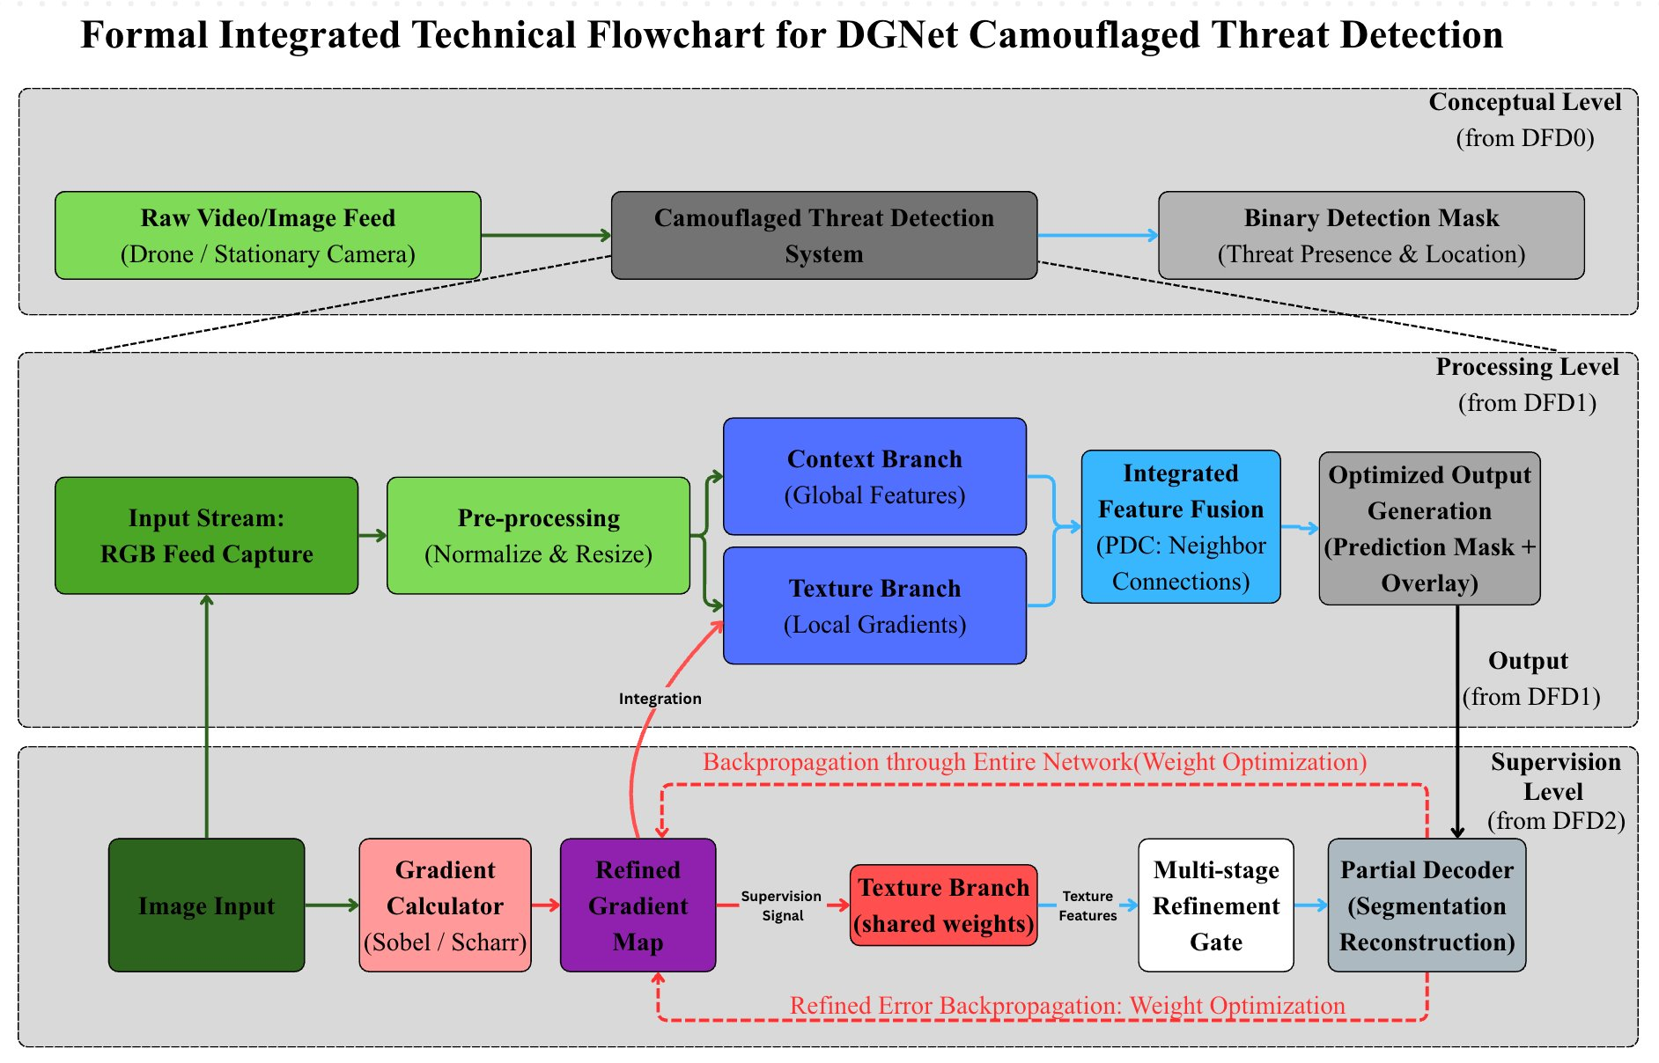
SYSTEM ARCHITECTURE
03-03-2025 Dept of AIML 19

Slide 20
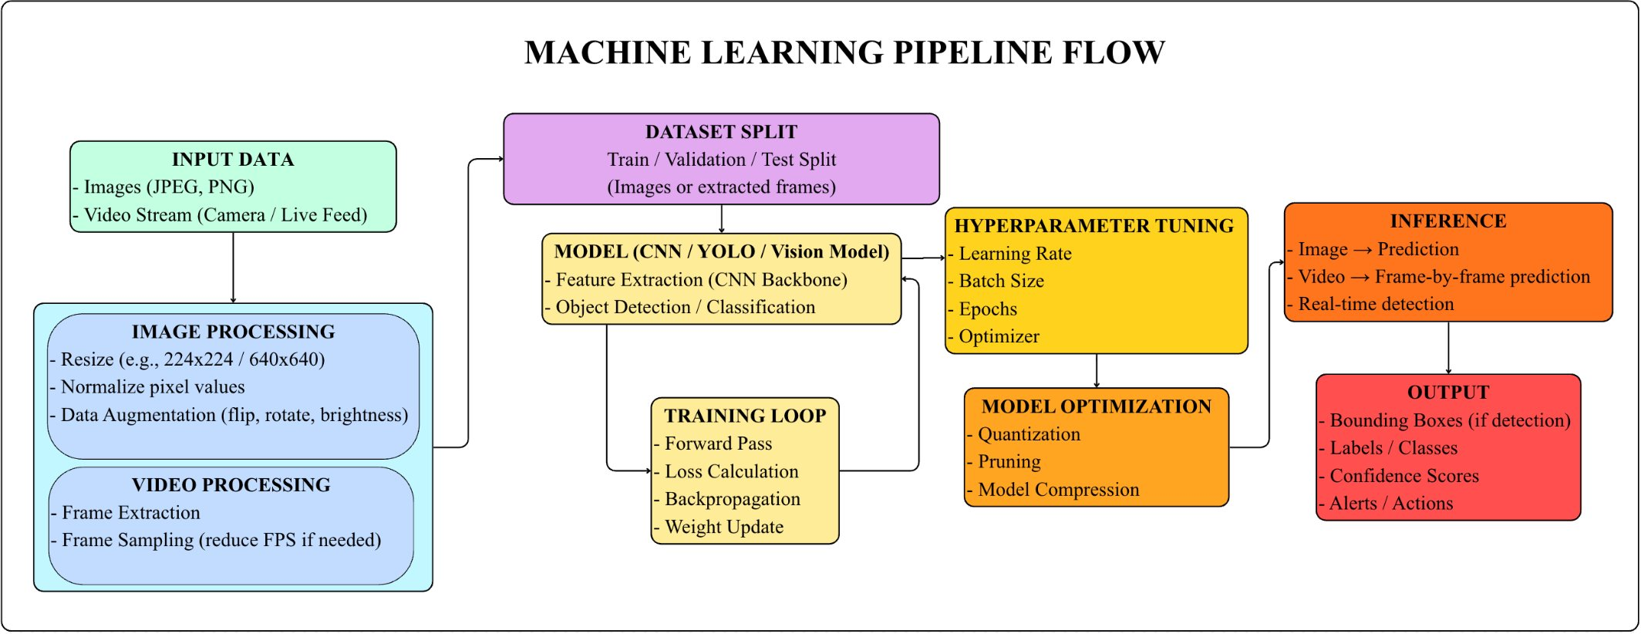
EXECUTION FLOW
03-03-2025 Dept of AIML 20

Slide 21
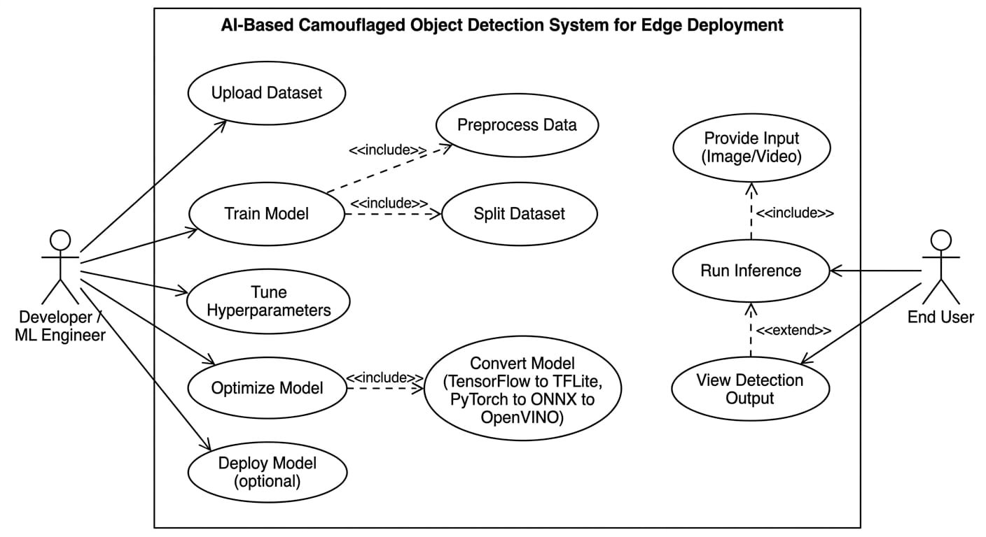
USE CASE DIAGRAM
03-03-2025 Dept of AIML 21

Slide 22
CONSTRAINTS
Limited Hardware Resources: Edge devices have restricted RAM, compute, and power budgets
Real-Time Requirement: Inference must complete within 100 ms per frame to ensure operational utility
Edge Device Limitations: No dedicated GPU on target platforms (Raspberry Pi); ARM CPU only
Dataset Bias: Training datasets may not fully represent all military terrain and camouflage types
Environmental Variability: Performance may degrade under extreme lighting or weather conditions
Security Restriction: No cloud connectivity permitted — all computation must be fully onboard
03-03-2025 Dept of AIML 22

Slide 23
TESTING & EVALUATION
Use TensorFlow Lite Model Analyzer to inspect model structure and compatibility
Use TFLite Interpreter (local testing) to measure:
Inference time
Memory usage
Use Google AI Edge / mobile benchmarking tools(flutter) for device testing
Evaluate performance using:
Latency
FPS (Frames Per Second)
Real-time inference capability
Evaluate using mAP, IoU, F1-score on COD10K, CAMO, NC4K test sets
03-03-2025 Dept of AIML 23

Slide 24
CONCLUSION
Designed a lightweight, hardware-aware camouflaged object detection system for edge deployment
Integrated model compression (quantization, pruning) to enable real-time inference on ARM CPUs
Proposed fully onboard autonomous pipeline with trigger-based response — no cloud dependency
Addresses key research gaps: edge hardware validation, real-time video processing, and efficiency
Balances detection accuracy and computational efficiency for real-world military surveillance use
Future work: multimodal fusion (RGB + IR), domain adaptation, and cross-terrain generalization
03-03-2025 Dept of AIML 24

Slide 25
REFERENCE
S, Ranjit. (2025). Camouflaged Military Personnel Detection Using SSIM-BasedFaster R-CNN Model. INTERNATIONAL JOURNAL OF ARTIFICIALINTELLIGENCE & MACHINE LEARNING. 4. 36-47.10.34218/IJAIML_04_02_003.
2. Laidouni, Mohammed Zouaoui & Bondzulic, Boban & Pavlović, Boban. (2025).Military Camouflaged Target Detection Through Multimodal Images: A ComparativeStudy.
3. Padhy, I., J, T.S.C.M.R., CH, V.K.R. et al. Camouflaged object detection usinghybrid-deep learning model. Multimed Tools Appl 84, 31771–31791 (2025).https://doi.org/10.1007/s11042-024-20371-z
4. Chen, H.; Wang, X.; Jin, H. Hybrid-Recursive-Refinement Network for CamouflagedObject Detection. J. Imaging 2025, 11, 299.https://doi.org/10.3390/jimaging110902995. Haider, A., Muhammad, G., Khan, T.A. et al. Identification of camouflage militaryindividuals with deep learning approaches DFAN and SINETV2. Sci Rep 15, 33271(2025). https://doi.org/10.1038/s41598-025-18886-y
Haider, A., Muhammad, G., Khan, T.A. et al. Identification of camouflage militaryindividuals with deep learning approaches DFAN and SINETV2. Sci Rep 15, 33271(2025). https://doi.org/10.1038/s41598-025-18886-y
03-03-2025 Dept of AIML 14

Slide 26
REFERENCE
6. J. Singh, “CamoVision: A Dual-Mode Deep Learning Framework for CamouflagedObject Detection in Images and Videos”, Eng. Technol. Appl. Sci. Res., vol. 15, no. 6,pp. 30154–30160, Dec. 2025.
7. Peng, Y., Wang, J., Yu, Z., You, Y., & Sun, Y. (2024). Camouflage soldier objectdetection network based on the attention mechanism and pyramidal feature shrinking.Multimedia Tools & Applications, 83(33), 79917–79938.https://doi.org/10.1007/s11042-024-18618-w
8. R. Peng et al., "Camouflaged Target Detection Based on Multimodal Image InputPixel-Level Fusion," in Frontiers of Information Technology & ElectronicEngineering, vol. 25, no. 9, pp. 1226-1239, January 2024, doi:10.1631/FITEE.2300503.
9. Hsiang, Han-Cheng & Wang, JinYuan & Liu, Yong. CPANet: Cross-DomainPolynomial Attention Network for Camouflaged Object Detection. IEEE Access. PP.1-1.
10.1109/ACCESS.2026.3655403.10. Yadav, A., Kumar, E. Object Detection on Real-Time Video with FPN and ModifiedMask RCNN Based on Inception-ResNetV2. Wireless Pers Commun 138, 2065–2090(2024). https://doi.org/10.1007/s11277-024-11539-9
03-03-2025 Dept of AIML 15

Slide 27
11. H. O. Velesaca, P. A. Mero, A. Reyes-Angulo and A. D. Sappa, "AINet: IntegratingMamba and CBAM for Enhanced Camouflage Object Detection," in IEEE Access,doi: 10.1109/ACCESS.2026.3668115.
12. Xiao, H., Liu, Z., Luo, F. et al. Ulcod-net: an ultra-lightweight camouflage objectdetection framework with gated multi-level feature fusion and dual-constraintrefinement. Complex Intell. Syst. 12, 76 (2026). https://doi.org/10.1007/s40747-025-02201-3
13. Fu, R.; Li, Y.; Chen, C.-C.; Duan, Y.; Yao, P.; Zhou, K. ATDMNet: Multi-Head AgentAttention and Top-k Dynamic Mask for Camouflaged Object Detection. Sensors2025, 25, 3001. https://doi.org/10.3390/s25103001
14. J. Yang and Y. Du, "Improved Camouflage Personnel Detection Based on YOLOv8,"2025 6th International Conference on Computer Vision, Image and Deep Learning(CVIDL), Ningbo, China, 2025, pp. 54-57, doi:10.1109/CVIDL65390.2025.11086024.
15. S, Ranjit. (2025). Camouflaged Military Personnel Detection Using SSIM-BasedFaster R-CNN Model. INTERNATIONAL JOURNAL OF ARTIFICIALINTELLIGENCE & MACHINE LEARNING. 4. 36-47.10.34218/IJAIML_04_02_003.
03-03-2025 Dept of AIML 16

Slide 28
16. Yuan, C.; Liu, L.; Li, Y.; Li, J. SAM2-DFBCNet: A Camouflaged Object DetectionNetwork Based on the Heira Architecture of SAM2. Sensors 2025, 25, 4509.https://doi.org/10.3390/s25144509
17. S. Liu, J. Zha, J. Sun, Z. Li and G. Wang, "EdgeYOLO: An Edge-Real-Time ObjectDetector," 2023 42nd Chinese Control Conference (CCC), Tianjin, China, 2023, pp.7507-7512, doi: 10.23919/CCC58697.2023.10239786
03-03-2025 Dept of AIML 17

